Slide 1

KALERWE
S.D.A Hymnal 601
4 ~ Verses
77.
Mmwe Abakuumi Ba Sayuuni.…
~
Watchmen on the Walls…

Slide 2

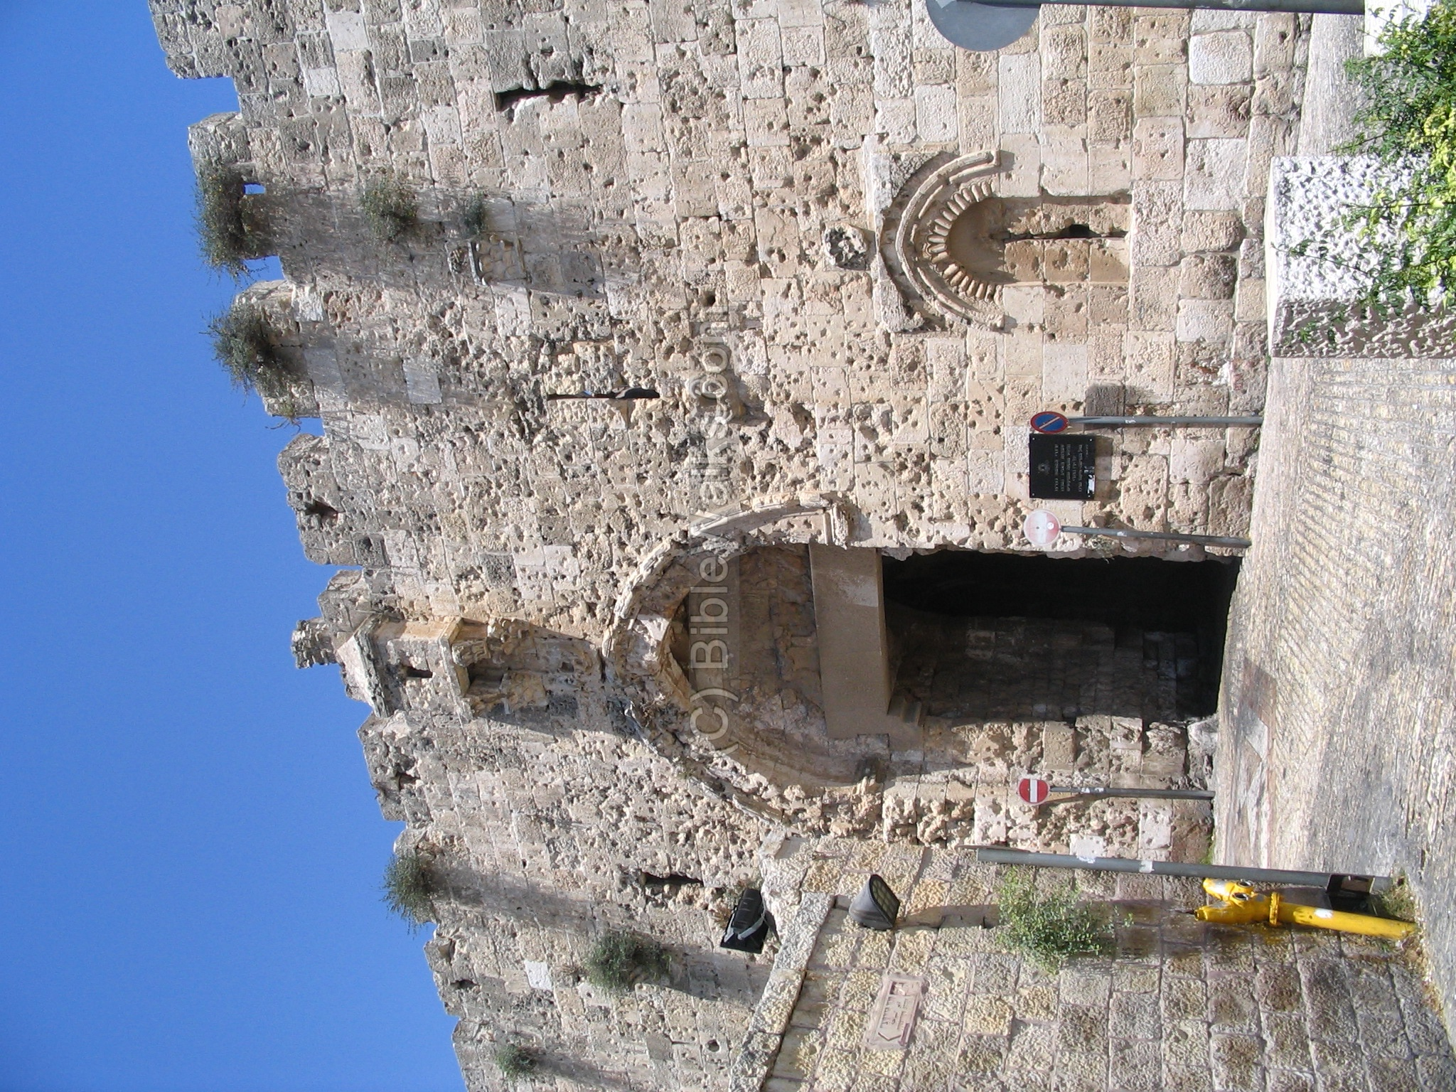
1 of 4 verses
Mwe (a)bakumi ba Sayuni
Obudde buli butya?
Ali kumpi (O)mulokozi
Okukomawo ku nsi?
Emmunyenye
ey’enkya mugirabye? Emmunyenye ey’enkya
tugirabye!

Slide 3
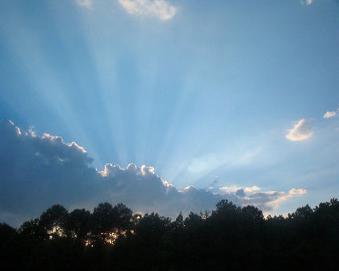
2 of 4 verses
Obudde butangala nnyo
Tuyimbe olw’essanyu
Emmambya yiiyo esaze
Nga emasamasa nnyo!
Tusanyuke Yesu Mukama ajja!
Tusanyuke Yesu Mukama ajja!

Slide 4
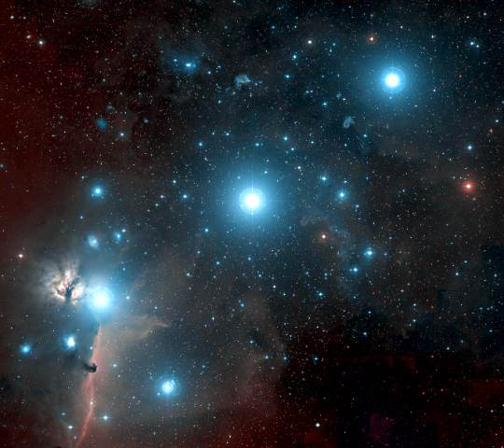
3 of 4 verses
Mwe (a)bakuumi mutegeeze
Obubonero bwaffe:
Tusemberedde omwalo,
(O)lukalu lulengerwa?
Tulengera (a)maka agomu ggulu?
Tulengera (a)maka ag’omu ggulu

Slide 5

4 of 4 verses
(O)bubonero tubulabye
Tunateer(a) okutuuka!
Tugende fenna mu maaso,
Twogerere waggulu.
Kusembedde (o)kununulibwa
kwaffe!
Kusembedde (o)kununulibwa
kwaffe!

